Slide 1
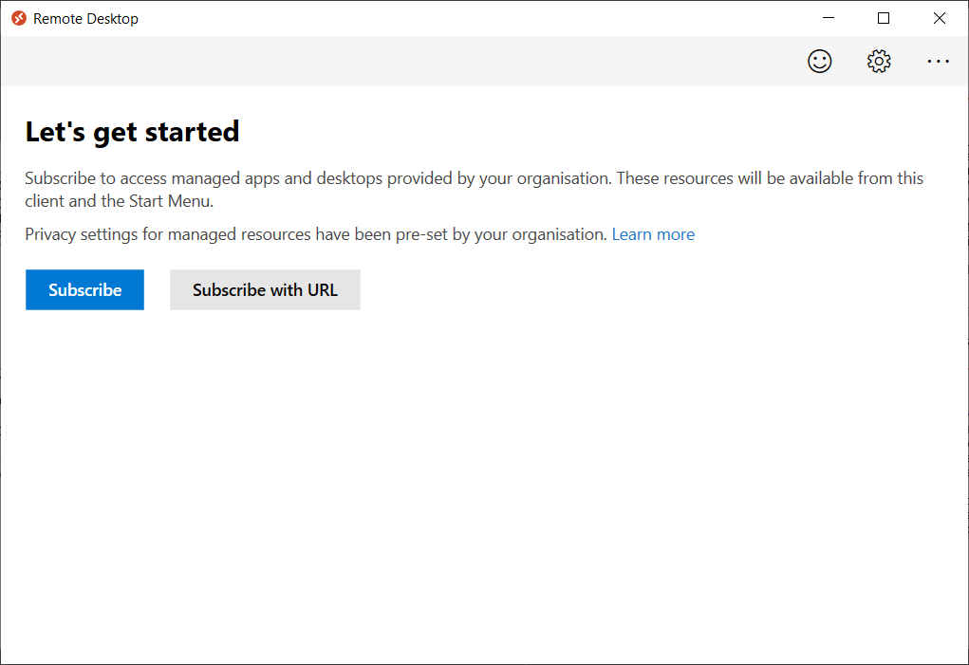
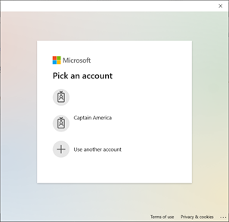
Azure Virtual Desktop Quick start Guide
Option 2: Subscribe with a URL
Enter the Workspace URL or your email address: https://rdweb.wvd.microsoft.com/api/arm/feeddiscovery
Option 1: Subscribe with a user account
From the main page of the client, select Subscribe.
Sign in with your user account when prompted.
The resources will appear in the Connection Center, and are grouped by workspace

Slide 2
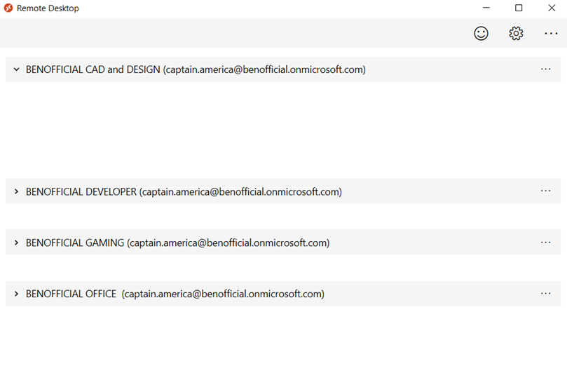
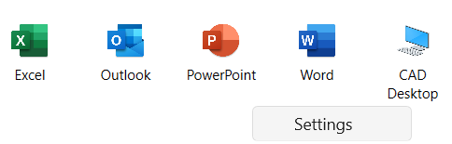
Azure Virtual Desktop Quick start Guide
Manage Settings
Send usage data to Microsoft
App Mode (Dark / Light)
More options
Subscribe
Subscribe with URL: You can access different Workspaces and with different user accounts. Add your Email or Workspace URL here (provided by your IT Team)
About: Display the Microsoft Remote Desktop Client version. Reset user data and restore default settings.
Help: Access the Microsoft documentation
What’s new: Access the Microsoft Change log.
Access the Feedback Hub
Access your Remote Apps and Desktops
Get the list of managed resources you can access, such as apps and desktops.
If an application or desktop is missing please contact the IT Helpdesk.
“Right-click” a Desktop to access the Settings.
The client will use the settings configured by your admin unless you turn off the Use default settings option. Doing so allows you to configure the following options:
Display configuration: All displays, Single display, Select display
Mode: windowed mode, full-screen mode and resolution size.
More options (Workspace)
Details: List Workspace details
Refresh: Refresh the Workspace to e.g. see new assigned Apps and Desktops.
Unsubscribe: Unsubscribe from Workspaces and disconnect from all Apps and Desktops immediately
Expand and minimize Workspaces

